Slide 1
Statistical Machine Translation
Jurafsky, D. and Martin, J. H. (2009): Speech and Language Processing. An Introduction to Natural Language Processing, Computational Linguistics and Speech Recognition. Second Edition. Pearson: New Jersey: Chapter 25
Material von Bonnie Dorr’s lecture
Material from Kevin Knight’s lecture at Berkeley, 2004
noisy channel model, word alignment, phrase-based translation
04.11.18
Language Technology Group – Chris Biemann

Slide 2
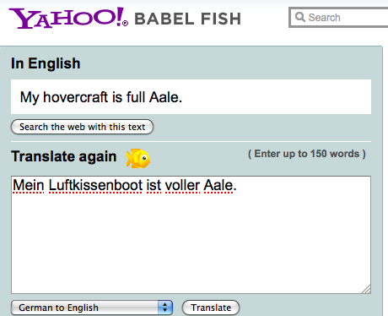
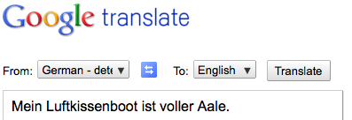
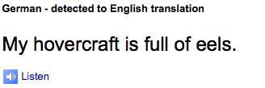
Rule-based vs. Statistical Machine Translation (MT)
https://www.babelfish.com
Rule-based MT:
Hand-written transfer rules
Rules can be based on lexical or structural transfer
Pro: firm grip on complex translation phenomena
Con: Often very labor-intensive, lack of robustness
Largely abandoned.
Statistical MT
Mainly word or phrase-based translations
Translation are learned from actual data
Pro: Translations are learned automatically
Con: Difficult to model complex translation phenomena
http://translate.google.com
04.11.18
Language Technology Group – Chris Biemann

Slide 3
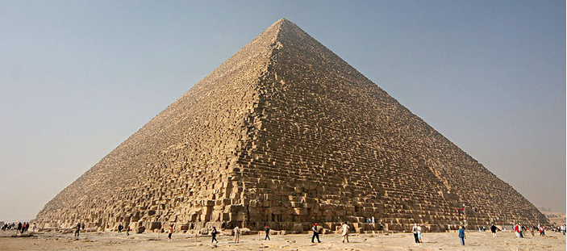
The Machine Translation Pyramid
Interlingua
Source meaning
Target meaning
rule-based
statistical
Source syntax
Target syntax
Source word
Target word
Analysis
Generation
04.11.18
Language Technology Group – Chris Biemann

Slide 4
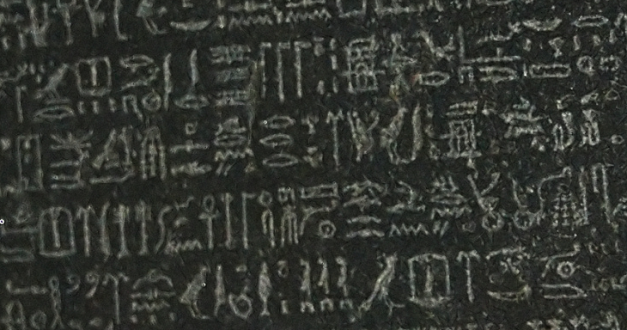
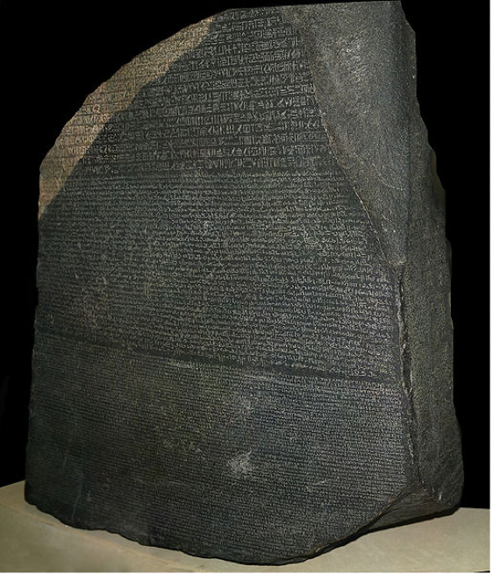


Parallel Corpus: Training resource for MT
Most popular:
EuroParl: European parliament protocols in 11 languages
Hansards: Canadian Parliament protocols in French and English
Software manuals (KDE, Open Office …)
Parallel webpages
For the remainder, we assume that we have a sentence-aligned parallel corpus.
there are methods to get to aligned sentences from aligned documents
there are methods to extract parallel sentences from comparable corpora
04.11.18
Language Technology Group – Chris Biemann

Slide 5

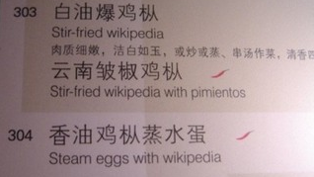


Fun bits
Early results from translating English into Russian and back to English:
The spirit is willing but the flesh is weak
➔The vodka is good but the meat is rotten
Out of sight, out of mind
➔ Invisible idiot

Slide 6
Computing Translation Probabilities
Imagine that we want to translate from French (f) into English (e).
Given a parallel corpus we can estimate P(e | f). The maximum likelihood estimation of P(e | f) is: freq(e,f)/freq(f)
Way too specific to get any reasonable frequencies when done on the basis of sentences, vast majority of unseen data will have zero counts
P(e | f ) could be re-defined as:
Problem: The English words maximizing P(e | f ) might not result in a readable sentence
04.11.18
Language Technology Group – Chris Biemann

Slide 7
Computing Translation Probabilities
We can account for adequacy: each foreign word translates into its most likely English word
We cannot guarantee that this will result in a fluent English sentence
Solution: transform P(e | f) with Bayes’ rule:
P(f | e) accounts for adequacy
P(e) accounts for fluency
04.11.18
Language Technology Group – Chris Biemann

Slide 8
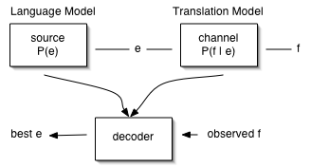
Statistical Machine Translation (SMT): The noisy channel model
SMT as a function e.g. of French (f) → English (e)
French is, in fact, English that was garbled by a noisy channel.
04.11.18
Language Technology Group – Chris Biemann

Slide 9
Three Problems for Statistical MT
Language model
Given a target language string e, assigns P(e) by formula
good target language string ➔ high P(e)
random word sequence ➔ low P(e)
Translation model
Given a pair of strings <f,e>, assigns P(f|e) by formula
<f,e> look like translations ➔ high P(f|e)
<f,e> don’t look like translations ➔ low P(f|e)
Decoding algorithm
Given a language model, a translation model, and a new sentence f: find translation e maximizing P(e)•P(f|e)
04.11.18
Language Technology Group – Chris Biemann

Slide 10
Language Modeling: P(e)
Determine the probability of an English sequence P(e)
Can use n-gram models, PCFG-based models etc.: anything that assigns a probability for a sequence
Standard: n-gram model
Language model picks the most fluent translation of many possible translations
Language model can be estimated from a large monolingual corpus
04.11.18
Language Technology Group – Chris Biemann

Slide 11
Translation Modeling: P(f|e)
Determines the probability that the foreign word f_{j} is a translation of the English word e_{i}
How to compute P(f_{j} | e_{i}) from a parallel corpus? Need to align their translations
Statistical approaches rely on the co-occurrence of e_{i} and f_{j} in the parallel data: If e_{i} and f_{j} tend to co-occur in parallel sentence pairs, they are likely to be translations of one another
Commonly, four factors are used:
translation: How often do e_{i} and f_{j} co-occur?
distortion: How likely is a word occurring at position x to translate into a word occurring at position y? For example: English is a verb-second language, whereas German is a verb-final language
fertility: How likely is e_{i} to translate into more than one word? For example: “defeated” can translate into "eine Niederlage erleiden"
null translation: How likely is a foreign word to be spuriously generated?
04.11.18
Language Technology Group – Chris Biemann

Slide 12
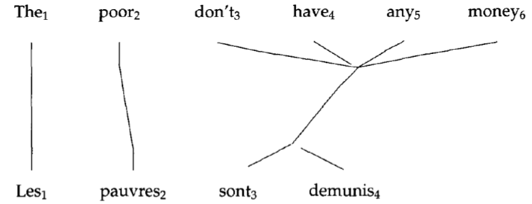
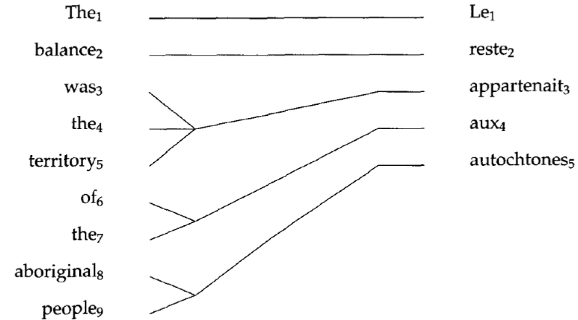
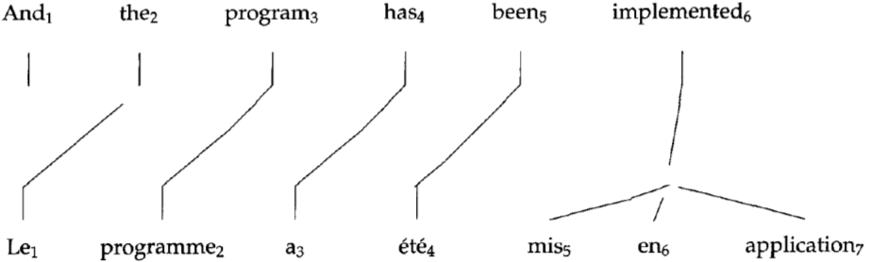
Alignment Examples
x
04.11.18
Language Technology Group – Chris Biemann

Slide 13
IBM Models 1-5
Model 1: Bag of words
Unique local maxima
Efficient EM algorithm (Model 1–2)
Model 2: General alignment:
Model 3: fertility: n(k | e)
No full EM, count only neighbors (Model 3–5)
Leaky (Model 3–4)
Model 4: Relative distortion, word classes
Model 5: Extra variables to avoid leakiness
Models of lower orders are used to initialize models of higher orders
04.11.18
Language Technology Group – Chris Biemann

Slide 14
IBM Models
Given an English sentence e¹… e^{l} and a foreign sentence f¹… f^{m}
We want to find the ’best’ alignment a, where a is a set of pairs of the form {(i , j), . . . , (i’, j’)}, 0<= i , i’ <= l and 1<= j , j’<= m
Note that if (i , j), (i’, j) are in a, then i equals i’, i.e. no many-to-one alignments are allowed
We add a spurious NULL word to the English sentence at position 0
In total there are (l+1)^{m} different alignments A
Allowing for many-to-many alignments results in (2^{l})^{m} possible alignments A
04.11.18
Language Technology Group – Chris Biemann

Slide 15
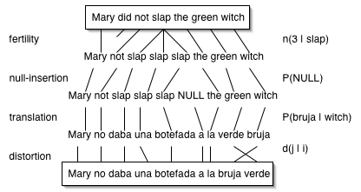
Translation steps in IBM models: generative view
04.11.18
Language Technology Group – Chris Biemann

Slide 16
IBM Model 1
Simplest of the IBM models
Does not consider word order (bag-of-words approach)
Does not model one-to-many alignments
Computationally inexpensive
Useful for parameter estimations that are passed on to more elaborate models
Translation probability in terms of alignments:
where:
and:
04.11.18
Language Technology Group – Chris Biemann

Slide 17
IBM Model 1
We want to find the most likely alignment:
We don’t need to enumerate all alignments: Since P(f ^{j}|e^{i}) is independent from P(f ^{j’}|e^{i’}) we can find the maximum alignment by looking at the individual translation probabilities only
Let , then for each a_{j}:
The best alignment can be computed in a quadratic number of steps: m(l+1)
04.11.18
Language Technology Group – Chris Biemann

Slide 18
Computing Model 1 Parameters
Step 1: Determine candidates. For each English word e collect all foreign words f that co-occur at least once with e
Step 2: Initialize P(f|e) uniformly, i.e. P(f|e) = 1/(number of co-occurring foreign words) or P(f|e) = 1/(number of total foreign words)
Step 3: Iteratively refine translation probabilities with EM: for n iterations
set tc to zero
for each sentence pair (e,f) of lengths (l,m)
for j=1 to m
total=0;
for i=1 to l: total += P(f^{j}|e^{i});
for i=1 to l: tc(f^{j}|e^{i}) += P(f^{j}|e^{i})/total;
for each word e
total=0;
for each word f s.t. tc(f|e) is defined: total += tc(f|e);
for each word f s.t. tc(f|e) is defined: P(f|e) = tc(f|e)/total;
04.11.18
Language Technology Group – Chris Biemann

Slide 19
IBM Model 1 example
Parallel ‘corpus’:
the dog :: der Hund
the tomcat :: der Kater
Step 1+2 (collect candidates and initialize uniformly):
P(der|the) = P(Hund|the) = P(Kater|the) = 1/3
P(der|dog) = P(Hund|dog) = P(Kater|dog) = 1/3
P(der|tomcat) = P(Hund|tomcat) = P(Kater|tomcat) = 1/3
P(der|NULL) = P(Hund|NULL) = P(Kater|NULL) = 1/3
Step 3: Iterate
NULL the dog :: der Hund
j=1
total = P(der|NULL)+P(der|the)+P(der|dog)= 1
tc(der|NULL) += P(der|NULL)/1 = 0 += .333/1 = 0.333
tc(der|the) += P(der|the)/1 = 0 += .333/1 = 0.333
tc(der|dog) += P(der|dog)/1 = 0 += .333/1 = 0.333
j=2
total = P(Hund|NULL)+P(Hund|the)+P(Hund|dog)=1
tc(Hund|NULL) += P(Hund|NULL)/1 = 0 += .333/1 = 0.333
tc(Hund|the) += P(Hund|the)/1 = 0 += .333/1 = 0.333
tc(Hund|dog) += P(Hund|dog)/1 = 0 += .333/1 = 0.333
04.11.18
Language Technology Group – Chris Biemann

Slide 20
IBM Model 1 example
NULL the tomcat :: der Kater
j=1
total = P(der|NULL)+P(der|the)+P(der|tomcat)=1
tc(der|NULL) += P(der|NULL)/1 = 0.333 += .333/1 = 0.666
tc(der|the) += P(der|the)/1 = 0.333 += .333/1 = 0.666
tc(der|tomcat) += P(der|tomcat)/1 = 0 +=.333/1 = 0.333
Re-compute translation probabilities
total(the) = tc(der|the) + tc(Hund|the) + tc(Kater|the) = 0.666 + 0.333 + 0.333 = 1.333
P(der|the) = tc(der|the)/total(the) = 0.666 / 1.333 = 0.5
P(Hund|the) = tc(Hund|the)/total(the) = 0.333/1.333 = 0.25
P(Kater|the) = tc(Kater|the)/total(the) = 0.333/1.333 = 0.25
total(dog) = tc(der|dog) + tc(Hund|dog) = 0.666
P(der|dog) = tc(der|dog)/total(dog) = 0.333 / 0.666 = 0.5
P(Hund|dog) = tc(Hund|dog)/total(dog) = 0.333 / 0.666 = 0.5
total(tomcat) = tc(der|tomcat) + tc(Kater|tomcat) = 0.333 + 0.333 =0.666
P(der|tomcat) = P(Kater|tomcat) = 0.5
total(NULL) = tc(der|NULL) + tc(Hund|NULL) + tc(KATER|NULL) = 0.666 + 0.333 + 0.333 = 1.333
P(der|NULL) = 0.5 P(Hund|NULL) = 0.25 P(Kater|NULL) = 0.25
j=2
total = P(Kater|NULL)+P(Kater|the)+P(Kater|tomcat)=1
tc(Kater|NULL) += P(Kater|NULL)/1 = 0 += .333/1 = 0.333
tc(Kater|the) += P(Kater|the)/1 = 0 += .333/1 = 0.333
tc(Kater|tomcat) += P(Kater|tomcat)/1 = 0 += .333/1 = 0.333
04.11.18
Language Technology Group – Chris Biemann

Slide 21
IBM Model 1 example
Iteration 2:
NULL the dog :: der Hund
j=1
total = P(der|NULL)+P(der|the)+P(der|dog) = 0.5 + 0.5 + 0.5 = 1.5
tc(der|NULL) += P(der|NULL)/1.5 = 0 += .5/1.5 = 0.333
tc(der|the) += P(der|the)/1.5 = 0 += .5/1.5 = 0.333
tc(der|dog) += P(der|dog)/1.5= 0 += .5/1.5 = 0.333
NULL the tomcat :: der Kater
j=1
total = P(der|NULL)+P(der|the)+P(der|tomcat)
= 0.5 + 0.5 + 0.5 = 1.5
tc(der|NULL) += P(der|NULL)/1.5 = 0.333 += .5/1.5 = 0.666
tc(der|the) += P(der|the)/1.5 = 0.333 += .5/1.5 = 0.666
tc(der|tomcat) += P(der|tomcat)/1.5= 0 += .5/1.5 = 0.333
j=2
total = P(Hund|NULL)+P(Hund|the)+P(Hund|dog) = 0.25 + 0.25 + 0.5 = 1
tc(Hund|NULL) += P(Hund|NULL)/1 = 0 += .25/1 = 0.25
tc(Hund|the) += P(Hund|the)/1 = 0 += .25/1 = 0.25
tc(Hund|dog) += P(Hund|dog)/1 = 0 += .5/1 = 0.5
j=2
total = P(Kater|NULL)+P(Kater|the)+P(Kater|tomcat) = 0.25 + 0.25 + 0.5 = 1
tc(Kater|NULL) += P(Kater|NULL)/1 = 0 += .25/1 = 0.25
tc(Kater|the) += P(Kater|the)/1 = 0 += .25/1 = 0.25
tc(Kater|tomcat) += P(Kater|tomcat)/1 = 0 += .5/1 = 0.5
04.11.18
Language Technology Group – Chris Biemann

Slide 22
IBM Model 1 example: Probs after Iteration 2
Re-compute translations (iteration 2):
total(the) = tc(der|the) + tc(Hund|the) + tc(Kater|the) = .666 + 0.25 + 0.25 = 1.166
P(der|the) = tc(der|the)/total(the) = .666 / 1.166= 0.57
P(Hund|the) = tc(Hund|the)/total(the) = 0.25/1.166 = 0.214
P(Kater|the) = tc(Kater|the)/total(the) = 0.25/1.166 = 0.214
total(dog) = tc(der|dog) + tc(Hund|dog) = 0.333 + 0.5 = 0.833
P(der|dog) = tc(der|dog)/total(dog) = 0.333 / 0.833 = 0.4
P(Hund|dog) = tc(Hund|dog)/total(dog) = 0.5 / 0.833 = 0.6
total(tomcat) = tc(der|tomcat) + tc(Kater|tomcat) = 0.333 + 0.5 = 0.833
P(der|tomcat) = 0.4 P(Kater|tomcat) = 0.6
total(NULL) = tc(der|NULL) + tc(Hund|NULL) + tc(KATER|NULL) = .666 + 0.25+ 0.25 = 1.166
P(der|NULL) = 0.57 P(Hund|NULL) = 0.214 P(Kater|NULL) = 0.214
➔Slowly, this example converges to the true translations
04.11.18
Language Technology Group – Chris Biemann

Slide 23
From Model 1 to Model 3
Model 1
IBM Model 1 allows for an efficient computation of translation probabilities
No notion of fertility, i.e., it is possible that the same English word is the best translation for all foreign words
No positional information, i.e., depending on the language pair, there might be a tendency that words occurring at the beginning of the English sentence are more likely to align to words at the beginning of the foreign sentence
Model 2+3
(3) Fertility: how likely does a single word align to several words
(2) Distortion: how likely is the alignment of a word in position i with a word in position j?
04.11.18
Language Technology Group – Chris Biemann

Slide 24
Fertility
The best Model 1 alignment could be that a single English word aligns to all foreign words
This is clearly not desirable and we want to constrain the number of words an English word can align to
Fertility models a probability distribution that word e aligns to k words: n(k,e)
Consequence: translation probabilities cannot be computed independently of each other anymore
IBM Model 3 has to work with full alignments, note there are up to (l+1)^{m} different alignments: this is infeasible
Solution: Compute the best alignment with Model 1 and change some of the alignments to generate a set of likely alignments (pegging)
Model 3 takes this restricted set of alignments as input
04.11.18
Language Technology Group – Chris Biemann

Slide 25
Neighborhood of an alignment
Fertility
Given an alignment a we can derive additional alignments from it by making small changes:
Changing a link (j,i) to (j,i’)
Swapping a pair of links (j,i) and (j’,i’) to (j,i’) and (j’,i)
The resulting set of alignments is called the neighborhood of a
Distortion
The distortion factor determines how likely it is that an English word in position i aligns to a foreign word in position j, given the lengths of both sentences: d(j | i, l, m). Note: positions are absolute positions
Then, use EM on the neighborhoods to find a better alignment
04.11.18
Language Technology Group – Chris Biemann

Slide 26
Deficiency: Leaky model!
Problem with IBM Model 3: It assigns probability mass to impossible strings
Well formed string: “This is possible”
Ill-formed but possible string: “This possible is”
Impossible string:
Impossible strings are due to distortion values that generate different words at the same position
Impossible strings can still be filtered out in later stages of the translation process
Again, leaky models are functional, but waste probability mass on impossible events.
“possible
This
is”
04.11.18
Language Technology Group – Chris Biemann

Slide 27
Limitations of IBM models (1-5)
Only 1-to-N word mapping
Handling fertility-zero words (difficult for decoding)
Almost no syntactic information
Word classes
Relative distortion
parse trees
Long-distance word movement
Fluency of the output depends entirely on the English language model
04.11.18
Language Technology Group – Chris Biemann

Slide 28
Phrase-Based Statistical MT
Morgen
fliege
ich
nach Kanada
zur Konferenz
Tomorrow
I
will fly
to the conference
In Canada
Foreign input segmented into phrases
“phrase” is any sequence of words
Each phrase is probabilistically translated into English
P(to the conference | zur Konferenz)
P(into the meeting | zur Konferenz)
Phrases are probabilistically re-ordered
04.11.18
Language Technology Group – Chris Biemann

Slide 29
Word Alignment Induced Phrases
Maria no dió una bofetada a la bruja verde
Mary
did
not
slap
the
green
witch
(Maria, Mary) (no, did not) (slap, dió una bofetada) (la, the) (bruja, witch) (verde, green)
04.11.18
Language Technology Group – Chris Biemann

Slide 30
Alignment templates: from words to phrases
Word-to-word alignment is a by-product of training a translation model like IBM-Model-3.
These are the best (or “Viterbi”) alignments.
E→F best
alignment
MERGE
F→E best
alignment
Union
04.11.18
Language Technology Group – Chris Biemann

Slide 31
How to learn the phrase translation table?
Maria no dió una bofetada a la bruja verde
Mary
did
not
slap
the
green
witch
one
example
phrase
pair
Collect all phrase pairs that are consistent with the word alignment
04.11.18
Language Technology Group – Chris Biemann

Slide 32
Consistent with Word Alignment
Maria no dió
Maria no dió
Maria no dió
Mary
did
not
slap
Mary
did
not
slap
 | x
Mary
did
not
slap
 |  | x
consistent
inconsistent
inconsistent
Phrase alignment must contain all alignment points for all the words in both phrases!
04.11.18
Language Technology Group – Chris Biemann

Slide 33
Word Alignment Induced Phrases
Maria no dió una bofetada a la bruja verde
Mary
did
not
slap
the
green
witch
(Maria, Mary) (no, did not) (slap, dió una bofetada) (la, the) (bruja, witch) (verde, green)
(a la, the) (dió una bofetada a, slap the)
(Maria no, Mary did not) (no dió una bofetada, did not slap), (dió una bofetada a la, slap the) (bruja verde, green witch)
(Maria no dió una bofetada, Mary did not slap) (a la bruja verde, the green witch) …
(Maria no dió una bofetada a la bruja verde, Mary did not slap the green witch)
04.11.18
Language Technology Group – Chris Biemann

Slide 34
Advantages of Phrase-based SMT
Many-to-many mappings can handle non-compositional phrases
takes both directions into account
Local context is very useful for disambiguating
“Interest rate” → …
“Interest in” → …
The more data, the longer the learned phrases: Sometimes whole sentences
04.11.18
Language Technology Group – Chris Biemann

Slide 35
Decoding
Goal is to find a translation that maximizes the product of the translation and language models.
Cannot explicitly enumerate and test the combinatorial space of all possible translations.
Must efficiently (heuristically) search the space of translations that approximates the solution to this difficult optimization problem.
The optimal decoding problem for all reasonable models (e.g. IBM model 1) is NP-complete.
Here:
phrase-based decoder based on that of Koehn’s (2004) Pharaoh system.
Pharaoh: a Beam Search Decoder for Phrase-Based Statistical Machine Translation Models, Philipp Koehn, AMTA 2004
04.11.18
Language Technology Group – Chris Biemann

Slide 36
Space of Translations
Maria | no | dio | una | bofetada | a | la | bruja | verde
Mary
not
give
a
slap
to
the
witch
green
did not
a slap
to the
green witch
no
slap
to
did not give
the
slap
the witch
The phrase translation table from the alignment defines the space of possible translations
every word can have multiple translations
every word can participate in multiple phrases
04.11.18
Language Technology Group – Chris Biemann

Slide 37
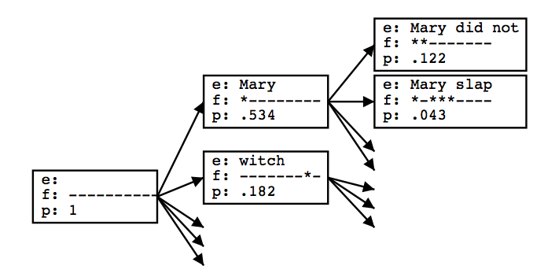
Stack Decoding
Use a version of heuristic A* search to explore the space of phrase translations to find the best scoring subset that covers the source sentence.
Initialize priority queue Q (stack) to empty translation.
Loop:
s = pop(Q)
If h is a complete translation, exit loop and return it.
For each refinement s´ of s created by adding a phrase translation
Compute score f(s´)
Add s´ to Q
Sort Q by score f
04.11.18
Language Technology Group – Chris Biemann

Slide 38
Search Heuristic
A* is best-first search using the function f to sort the search queue:
f(s) = g(s) + h(s)
g(s): Cost of existing partial solution
h(s): Estimated cost of completion of solution
If h(s) is an underestimate of the true remaining cost (admissible heuristic) then A* is guaranteed to return an optimal solution.
Known quality of partial translation, E, composed of a set of chosen phrase translations S based on phrase translation and language models:
04.11.18
Language Technology Group – Chris Biemann

Slide 39
Estimating the future cost
True future cost requires knowing the way of translating the remainder of the sentence in a way that maximizes the probability of the final translation.
However, this is not computationally tractable.
Therefore under-estimate the cost of remaining translation by ignoring the distortion component and computing the most probable remaining translation ignoring distortion (which is efficiently computable using the Viterbi algorithm)
04.11.18
Language Technology Group – Chris Biemann

Slide 40
Beam Search
However, Q grows too large to be efficient and guarantee an optimal result with full A* search.
Therefore, always cut Q back to only the best (lowest cost) K items to approximate the best translation
Initialize priority queue Q (stack) to empty translation.
Loop:
If top item on Q is a complete translation, exit loop and return it.
For each element s of Q do
For each refinement s´ of s created by adding a phrase translation
Compute score f(s´)
Add s´ to Q
Sort Q by score f
Prune Q back to only the first (lowest cost) K items
04.11.18
Language Technology Group – Chris Biemann

Slide 41
Multistack decoding
It is difficult to compare translations that cover different fractions of the foreign sentence, so maintain multiple priority queues (stacks), one for each subset of foreign words currently translated.
this prevents us from pruning solutions that cover all words: we prune per stack
Finally, return best scoring translation in the queue of translations that cover all of the words in F.
04.11.18
Language Technology Group – Chris Biemann

Slide 42
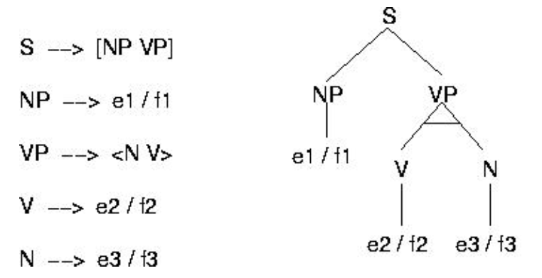
Directions in SMT
Hierarchical Phrase-based SMT: change from flat phrase model to model where phrases contain each other and use statistics over parts
Syntax-based models: Parallel grammar learning, e.g. Inversion Transduction Grammar, Tree-to-string, Tree-to-tree etc.
Semantics-based models: Mapping via frames/semantic symbols
poner
butter
:subj
:obj
:mod
→
:subj
:obj
X
mantequilla
en
X
Y
:obj
Y
X puso mantequilla en Y
X buttered Y
04.11.18
Language Technology Group – Chris Biemann

Slide 43
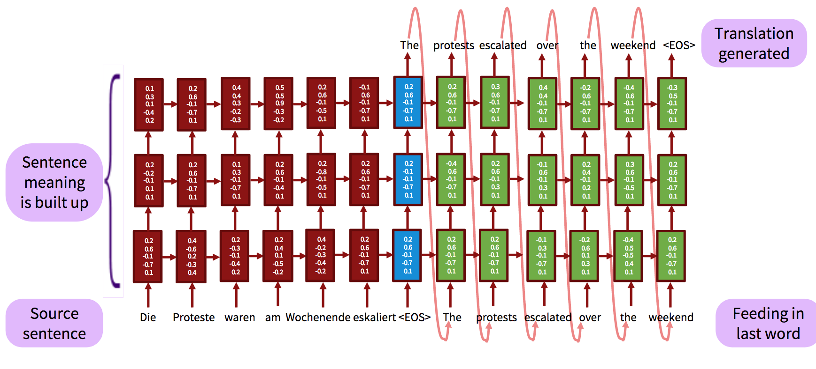
Sequence to Sequence Neural MT
Encoding/decoding with (recurrent) LSTMs
Ilya Sutskever, Oriol Vinyals, and Quoc Le. 2014. Sequence to Sequence Learning with Neural Networks, Proc. NIPS 2014
Tutorial: see https://nlp.stanford.edu/projects/nmt/Luong-Cho-Manning-NMT-ACL2016-v4.pdf
04.11.18
Language Technology Group – Chris Biemann

Slide 44
Advantages of Neural MT
End-to-End training: all parameters are simultaneously optimized
Distributed dense-vector representations: exploits word similarities
‘Infinite’ context: neural models better make use of long-range contexts

Slide 45
MT Evaluation
Manual:
SSER (subjective sentence error rate)
Correct/Incorrect
Error categorization
Testing in an application that uses MT as one sub-component
Question answering from foreign language documents
Cross Language Information Retrieval
Automatic:
WER (word error rate)
BLEU (Bilingual Evaluation Understudy)
04.11.18
Language Technology Group – Chris Biemann

Slide 46
BLEU Evaluation Metric
Reference (human) translation: The U.S. island of Guam is maintaining a high state of alert after the Guam airport and its offices both received an e-mail from someone calling himself the Saudi Arabian Osama bin Laden and threatening a biological/chemical attack against public places such as the airport .
N-gram precision (score is in [0,1] )
What percentage of machine n-grams can be found in the reference translation?
Not allowed to use same portion of reference translation twice (can’t cheat by typing out “the the the the the”)
Brevity penalty
Can’t just type out single word “the” (precision 1.0!)
Amazingly hard to “game” the system (i.e., find a way to change machine output so that BLEU goes up, but quality doesn’t)
Machine translation: The American [?] international airport and its the office all receives one calls self the sand Arab rich business [?] and so on electronic mail , which sends out ; The threat will be able after public place and so on the airport to start the biochemistry attack , [?] highly alerts after the maintenance.
04.11.18
Language Technology Group – Chris Biemann

Slide 47
BLEU Evaluation Metric
Reference (human) translation: The U.S. island of Guam is maintaining a high state of alert after the Guam airport and its offices both received an e-mail from someone calling himself the Saudi Arabian Osama bin Laden and threatening a biological/chemical attack against public places such as the airport .
BLEU4 formula
(counts n-grams up to length 4)
exp (1.0 * log p1 +
0.5 * log p2 +
0.25 * log p3 +
0.125 * log p4 –
max(words-in-reference / words-in-machine – 1, 0) )
p1 = 1-gram precision
p2 = 2-gram precision
p3 = 3-gram precision
p4 = 4-gram precision
Machine translation: The American [?] international airport and its the office all receives one calls self the sand Arab rich business [?] and so on electronic mail , which sends out ; The threat will be able after public place and so on the airport to start the biochemistry attack , [?] highly alerts after the maintenance.
04.11.18
Language Technology Group – Chris Biemann

Slide 48
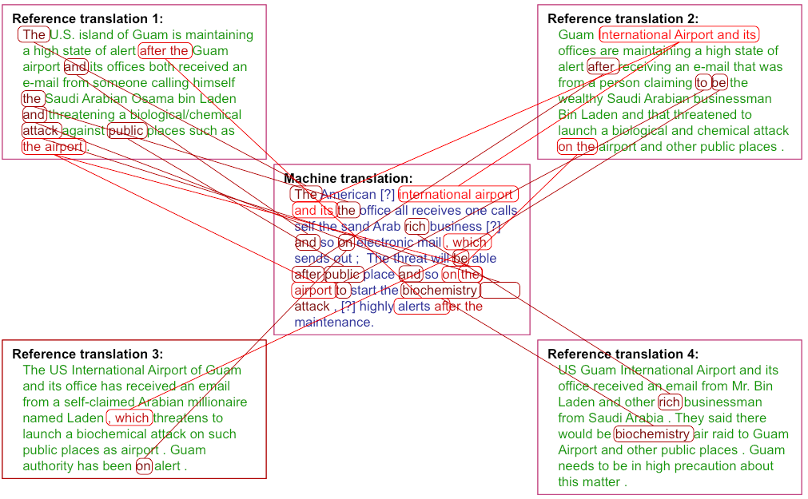
Multiple reference translations
Reference translation 1: The U.S. island of Guam is maintaining a high state of alert after the Guam airport and its offices both received an e-mail from someone calling himself the Saudi Arabian Osama bin Laden and threatening a biological/chemical attack against public places such as the airport .
Reference translation 1: The U.S. island of Guam is maintaining a high state of alert after the Guam airport and its offices both received an e-mail from someone calling himself the Saudi Arabian Osama bin Laden and threatening a biological/chemical attack against public places such as the airport .
Reference translation 2: Guam International Airport and its offices are maintaining a high state of alert after receiving an e-mail that was from a person claiming to be the wealthy Saudi Arabian businessman Bin Laden and that threatened to launch a biological and chemical attack on the airport and other public places .
Reference translation 2: Guam International Airport and its offices are maintaining a high state of alert after receiving an e-mail that was from a person claiming to be the wealthy Saudi Arabian businessman Bin Laden and that threatened to launch a biological and chemical attack on the airport and other public places .
Machine translation: The American [?] international airport and its the office all receives one calls self the sand Arab rich business [?] and so on electronic mail , which sends out ; The threat will be able after public place and so on the airport to start the biochemistry attack , [?] highly alerts after the maintenance.
Machine translation: The American [?] international airport and its the office all receives one calls self the sand Arab rich business [?] and so on electronic mail , which sends out ; The threat will be able after public place and so on the airport to start the biochemistry attack , [?] highly alerts after the maintenance.
Reference translation 3: The US International Airport of Guam and its office has received an email from a self-claimed Arabian millionaire named Laden , which threatens to launch a biochemical attack on such public places as airport . Guam authority has been on alert .
Reference translation 3: The US International Airport of Guam and its office has received an email from a self-claimed Arabian millionaire named Laden , which threatens to launch a biochemical attack on such public places as airport . Guam authority has been on alert .
Reference translation 4: US Guam International Airport and its office received an email from Mr. Bin Laden and other rich businessman from Saudi Arabia . They said there would be biochemistry air raid to Guam Airport and other public places . Guam needs to be in high precaution about this matter .
Reference translation 4: US Guam International Airport and its office received an email from Mr. Bin Laden and other rich businessman from Saudi Arabia . They said there would be biochemistry air raid to Guam Airport and other public places . Guam needs to be in high precaution about this matter .
04.11.18
Language Technology Group – Chris Biemann

Slide 49
BLEU Tends to Predict Human Judgments
Scores normalized to zero mean and unit variance - slide from G. Doddington (NIST)
04.11.18
Language Technology Group – Chris Biemann

Slide 50
Dense Vector Representations
coming up next
LSA, LDA, word2vec

